Slide 1
Electronic application systems
UPOV CAJ
Geneva, 17 October 2011
Jean Maison

Slide 2
Electronic application systems
Introduction
How to access?
The application form and the technical questionnaire
Statistics about the use of the system
Sharing the System with National Authorities
The electronic exchange of data

Slide 3
Electronic application systems
Introduction
The Office released its on-line application system in March 2010
For a limited number of species, which gradually increased
System only available in English for the moment but French, Dutch and German foreseen in the coming months

Slide 4
Introduction
System developed internally with the help of an external company
Technical basis: Zend Framework (Open Source software) and Oracle Database.
Feedback from applicants regularly taken into account and implemented.
Tests phases
Meetings with breeders’ associations
Electronic application systems

Slide 5
How to access?

Slide 6
How to access ?
The way of access is an important issue:
Security aspects
Identification – signature aspects
Should be acceptable for the National authority’s legislation
Should not be too complicated in order to keep the system user friendly
The CPVO adapted its legislation accordingly

Slide 7
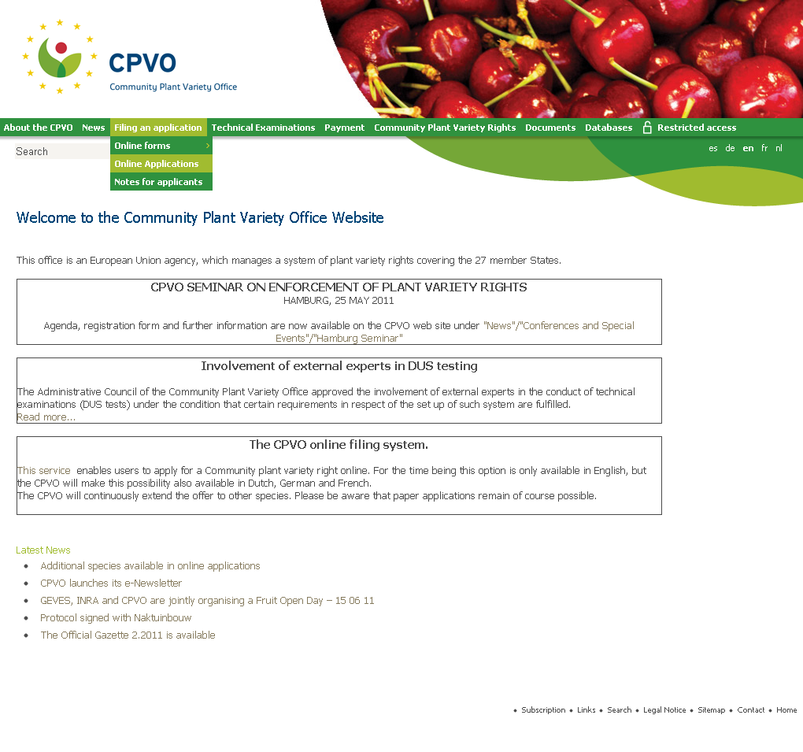
Client extranet

Slide 8
Thank you for your attention

Slide 9
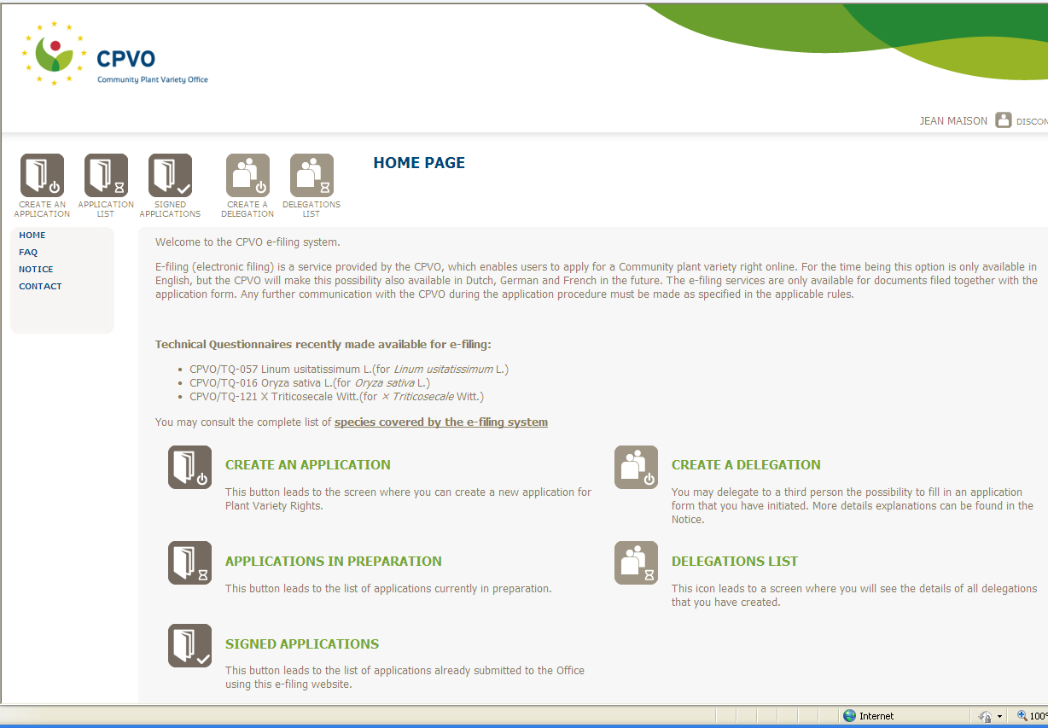

Slide 10
The application form and the technical questionnaire

Slide 11
The application form and the technical questionnaire
General characteristics of the forms:
Linear forms
Generated each time they are called on the screen, from a database of questions
Easy and centralized update for question in common to all forms
Each question can be translated in various languages

Slide 12
The application form and the technical questionnaire
General characteristics of the forms:
A few features illustrating the user friendliness
Possibility to fold – unfold questions
Possibility to save data, validate them
Controls on replies to questions

Slide 14
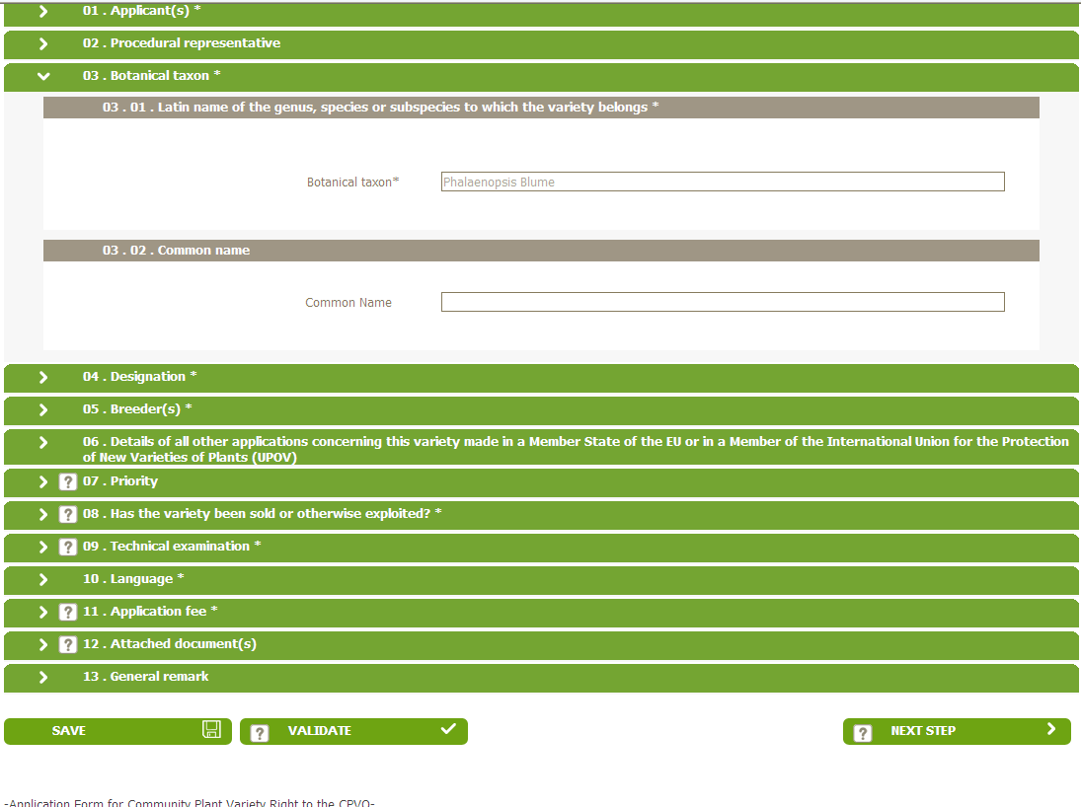

Slide 15
The application form and the technical questionnaire
General characteristics of the forms:
A few features illustrating the user friendliness
Auto completion
Possibility to append documents

Slide 17
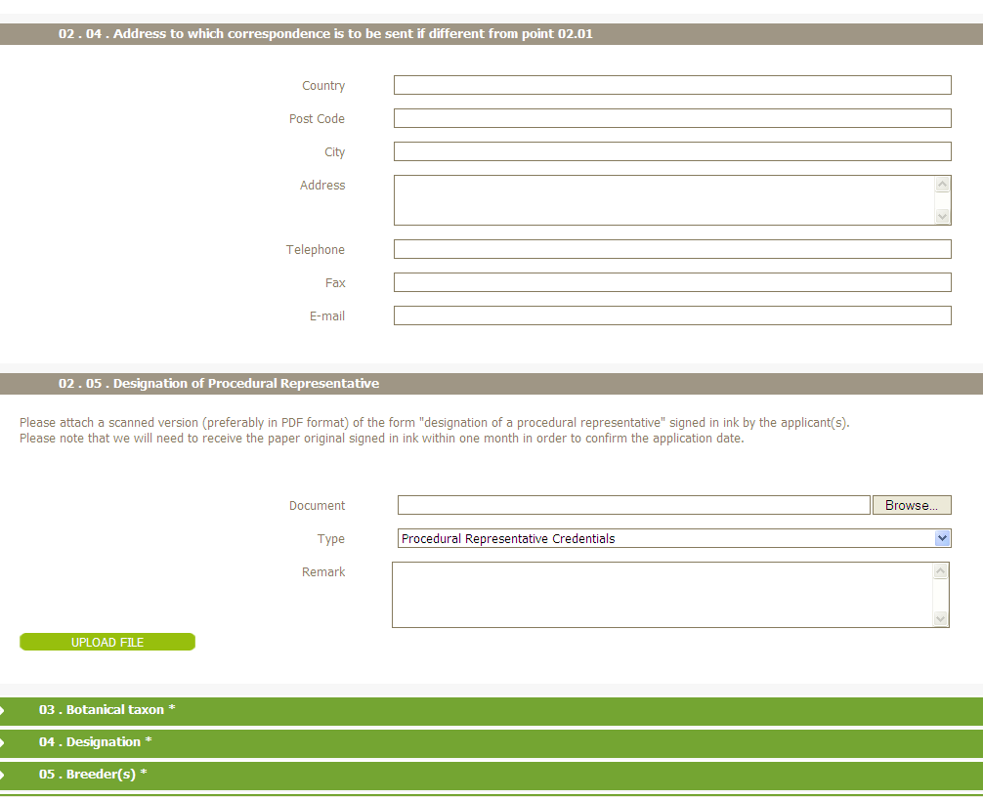

Slide 18
The application form and the technical questionnaire
General characteristics of the forms:
A few features illustrating the user friendliness
Less forms: proposal for a denomination included in the main application form

Slide 19
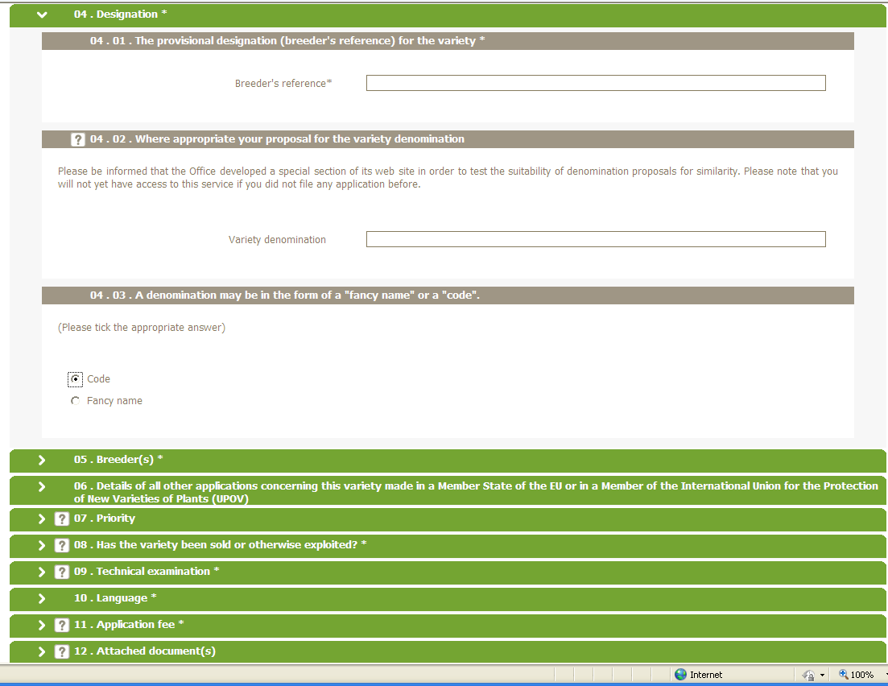

Slide 20
How to access
General characteristics of the forms:
A few features illustrating the user friendliness
Shorter form
Confidential option at various places

Slide 23
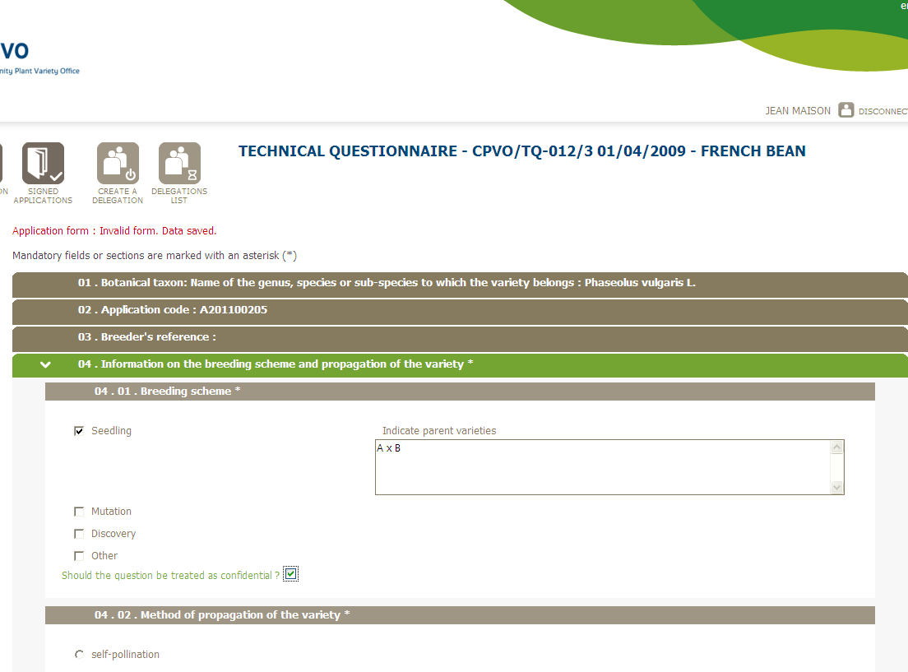

Slide 24
The application form and the technical questionnaire
General characteristics of the forms:
A few features illustrating the user friendliness
Automatic checks, preventing from sending the form

Slide 25
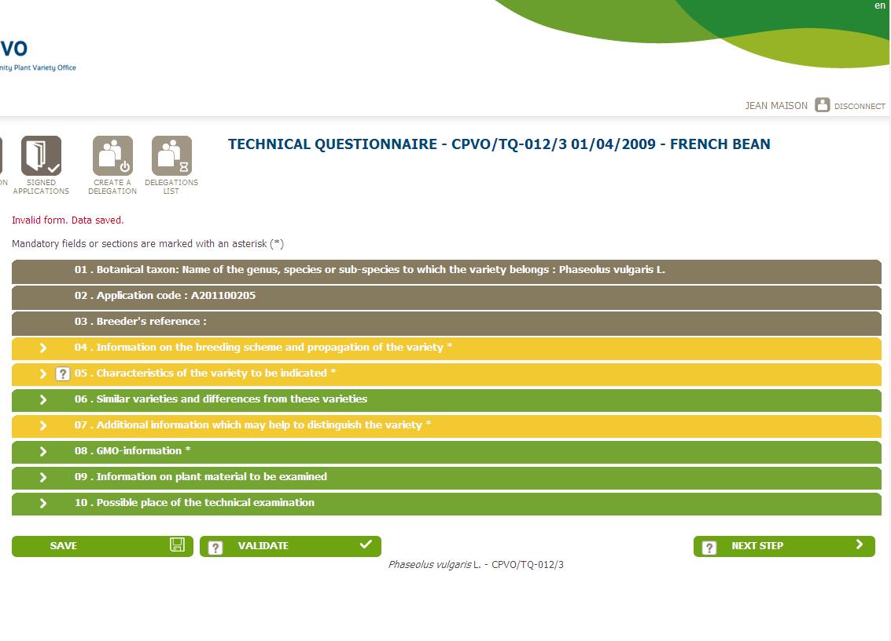

Slide 26
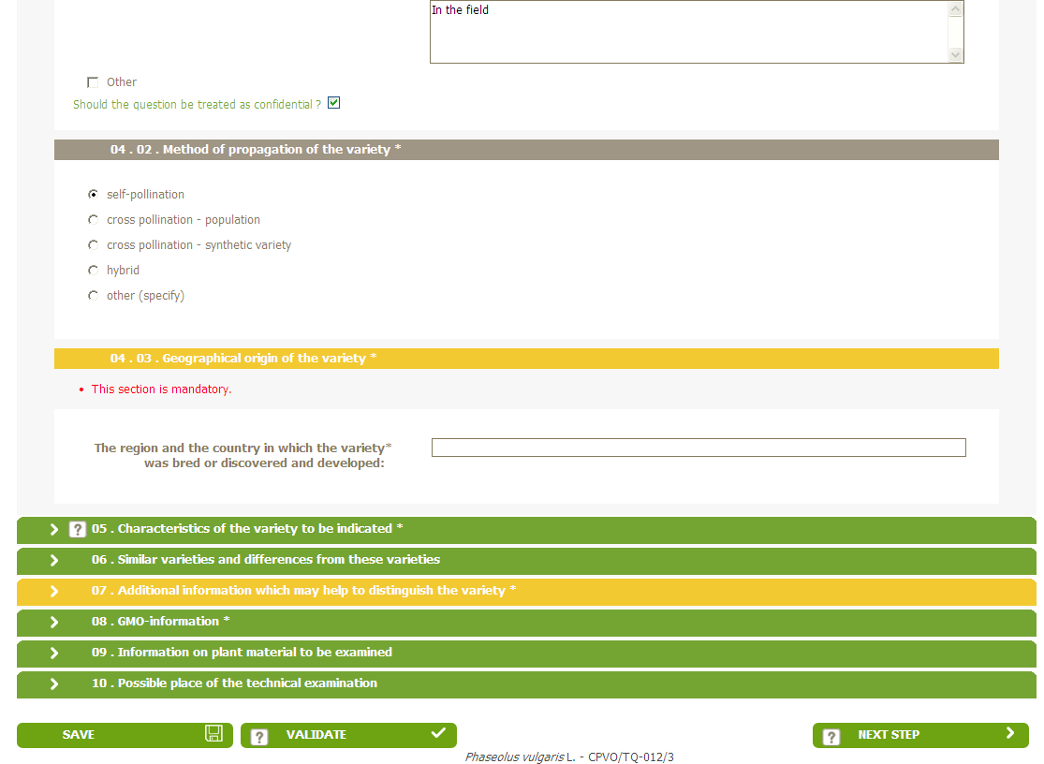

Slide 27
The application form and the technical questionnaire
General characteristics of the forms:
A few features illustrating the user friendliness
Simple signature system

Slide 28
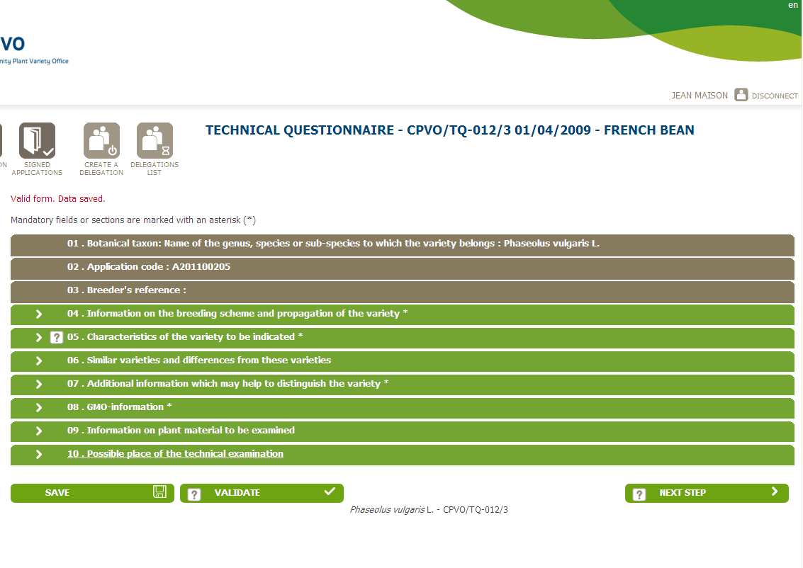

Slide 29
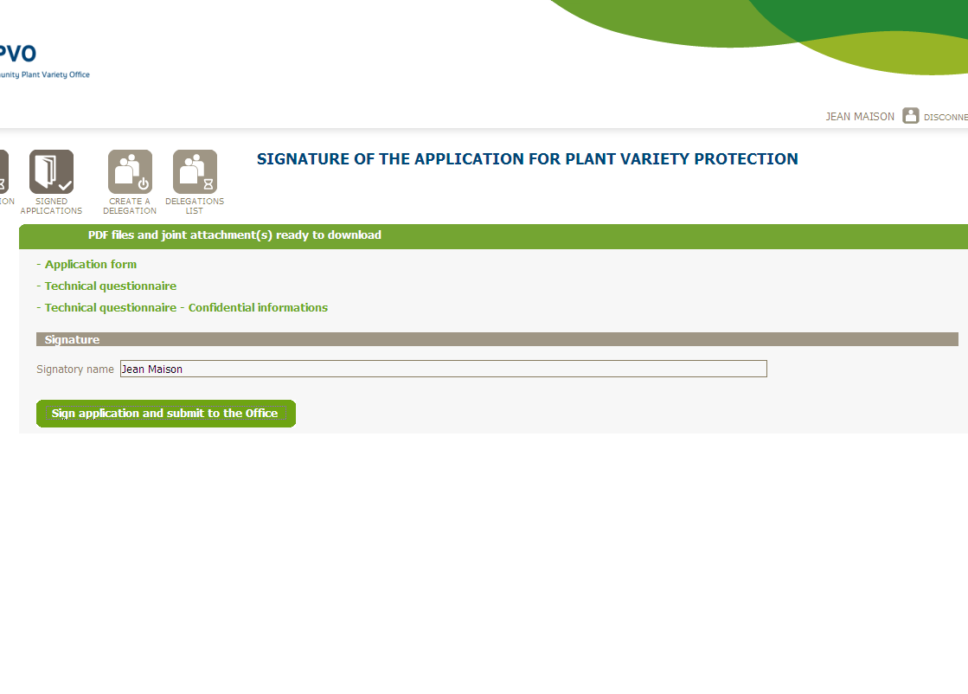

Slide 30
Some statistics

Slide 31
Evolution of the number of on-line applications

Slide 32
Sharing the system with National authorities

Slide 33
Sharing the system with National authorities
The Office presented the system in 2010 to EU Member States interested with the intention to make it available to MS authorities willing to use it.
Various issues to be considered where discussed in a scenario where national authorities are interested in sharing the CPVO online application system

Slide 34
In particular
Applications for PVR or NLI would be made via the National web site or via a centralised web site
www.plantvarieties.eu
The main elements of the corporate identity of participating National Authorities could be taken over
Sharing the system with National authorities

Slide 35
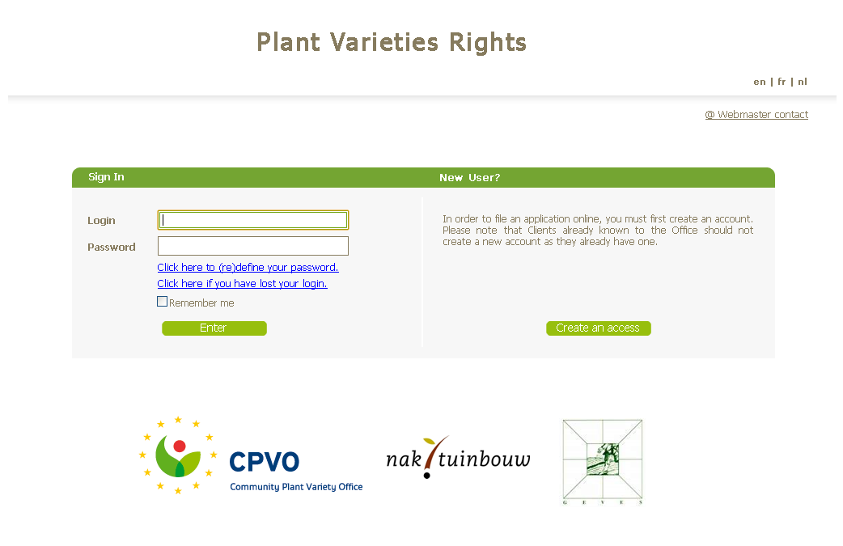
Sharing the system with National authorities

Slide 36
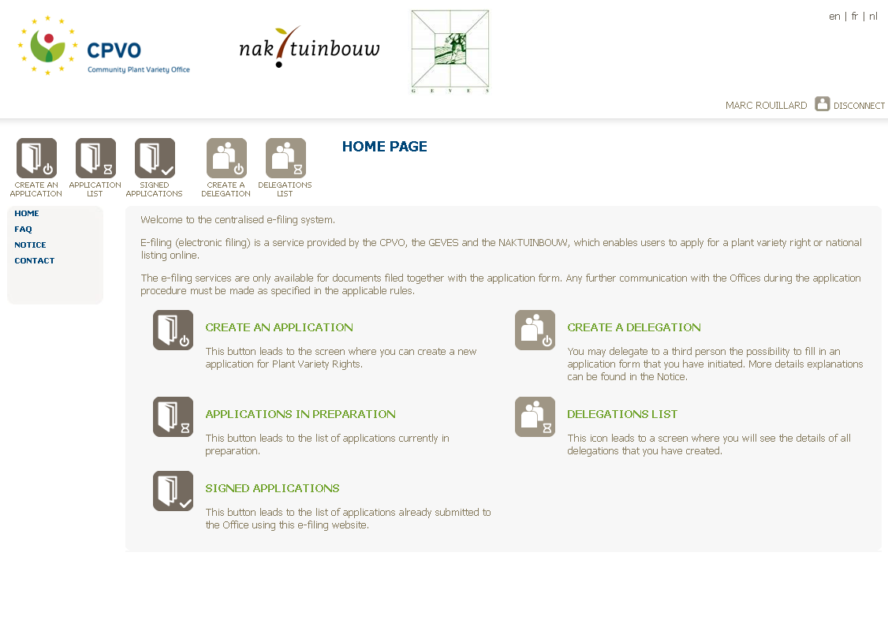
Sharing the system with National authorities

Slide 37
www.plantvarieties.eu
1
Country
2
Procedure
PBR
National listing
3
Select an existing application in a procedure and transfer it to another procedure
Form
Authorities
CPVO set of questions
National set of questions
National set of questions

Slide 38
In particular
The starting point for forms would be the CPVO set of questions but National authorities would have the possibility to add and manage an additional set of question
The e-signatures system of the CPVO could be taken over, or it would be up to each National Authority to develop its own system
Sharing the system with National authorities

Slide 39
Sharing the system with National authorities
In particular
National Authorities would receive applications in pdf format or similar

Slide 40
Sharing the system with National authorities
A pilot project was set up with GEVES for Maize and NAKT for tomato, with the objectives
to have it operational by the end of the year
to assess possibilities
to enlarge the project to other species
to enlarge the project to other countries, under which condition (technical, IT involvement, financial)

Slide 41
Sharing the system with National authorities
In the medium-longer term, it is the objective of the Office to set up an electronic exchange of data that can be downloaded directly in examination offices databases in future.

Slide 42
The electronic exchange of data

Slide 43
The electronic exchange of data
Principle: electronic data should no longer be printed out, in a form, send by post and typed again
XML

Slide 44
www.online-plantvarieties.eu
www.plantvarieties.eu
www.plant-varieties.eu
1
Country
2
NLI
PBR
3
Select an existing application in a procedure and transfer it to another procedure
Form
Authorities
CPVO set of questions
National set of questions
National set of questions

Slide 45
The electronic exchange of data
The XML file is linked to a variety and contains data linked to a given procedure about that variety, potentially including documents:
Application data
Procedural data (e.g. data about receipts, place of technical examination etc …)
Technical data (e.g. examination report data)
Whole range of data progressively complemented by various stakeholders during the development of the procedure

Slide 46
The electronic exchange of data
Variety A
XML
Application data + application date + request for TO/TE + date of request etc …
Variety A
XML
Application data
CPVO
Examination office
Selected range of data & variety description
All previous data
+ foreseen date for report + date of preliminary report + reference examination office etc …
Variety A
XML
Variety A
XML

Slide 47
The electronic exchange of data
The XML file enables a transfer of data automatically in databases from the stakeholders, without having to type them again
Prior to doing this, a check of data considered is highly recommended

Slide 48
The electronic exchange of data
Need for a common structure of the XML file
It is of interest of all stake holders to be able to read this XML file
All stakeholders should be involved in the discussion, breeders, examination offices, national authorities, CPVO

Slide 49
The electronic exchange of data
Example of two ways of structuring information for IT purposes :
Database country A
Name: John Doe
Company: SomeCorp Inc.
Address: P.O.Box 12345
High Street, 28
Brighton BN20AD
Country: United Kingdom
Database country B
FirstName: John
LastName: Doe
Title: Mr.
Position:
CompanyName: SomeCorp Inc.
POBox: 12345
Address1: High Street, 28
Address2:
City: Brighton
ZipCode: BN20AD
Country: UK

Slide 50
The electronic exchange of data
There can be as many structures as different Authorities/Clients
Define a common structure
Define a common dictionary
Example: country (country name or country code?), address (full address or street and number?)

Slide 51
The electronic exchange of data
A norm already exists (WIPO’s XML4IP, to become norm ST.96 )
Nominative information (names, addresses, email, function…)
Financial information (invoices, payments)
Flat files for textual and image data (Reports, photos)
=> generally speaking, administrative information
What’s missing for PBR purposes?

Slide 52
The electronic exchange of data
Plant Varieties Rights Potential examples:
Variety description (characteristics, scores)
Relationships between parties (Representatives, Breeders, Applicants)
Commercialization data (country, date, type)
=> need for additional business-specific XML schemas to represent technical PBR data

Slide 53
The electronic exchange of data
CPVO Project for XML exchange to start in 2012
Study WIPO IP-related norms
Identify missing PBR specific information
Set up a working group to define common structure and dictionary with the aim to implement it in XML format

Slide 54
The electronic exchange of data
CPVO Project for XML exchange to start in 2012
Participants to the working group: interested stakeholders of the system
Breeders
Breeders associations
Applicants
Procedural Representatives
Examination Offices
National Authorities
CPVO
UPOV
Report to UPOV

Slide 55
The electronic exchange of data
The CPVO aims to make available an XML scheme to
submit data to the CPVO
Receive data from the CPVO
More generally, exchange data between stakeholders in the UPOV world

Slide 56
Thank you for your attention

